Slide 1
L8_Projection of Line 3
B. SANTHI
Assistant t Professor
Department of MECHANICAL Engineering
NIT Goa

Slide 2
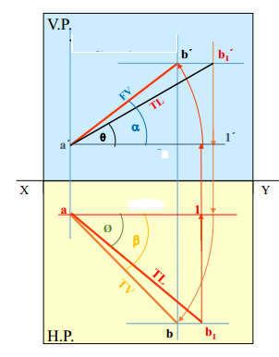
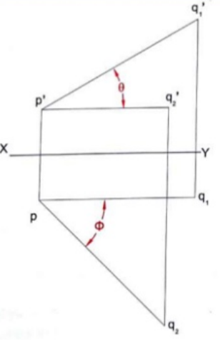
FV of line AB is 500 inclined to XY and measures 55 mm long while it’s TV is 600 inclined to XY line. If end A is 10 mm above HP and 15 mm in front of VP, draw it’s projections, find TL, inclinations of line with HP & VP.
1) True Length (TL) – a’ b1’ & a b1 2) Angle of TL with HP -θ 3) Angle of TL with VP –Ø 4) Angle of FV with XY –α 5) Angle of TV with XY – β
Hint: do the reverse procedure to get the solution

Slide 3
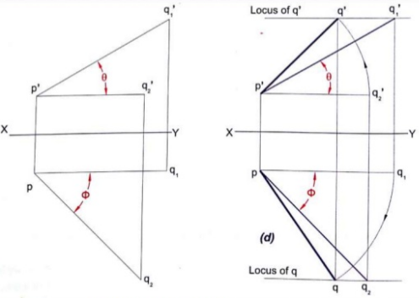
Line AB is 75 mm long. It’s FV and TV measure 50 mm & 60 mm long respectively.
A end is 10 mm above HP and 15 mm in front of VP.
Draw projections of line AB if end B is in first quadrant. Find angle with HP and VP
Hint: locating the 75mm length along the locas of the B for the length of 50mm.
Or
Fix the 60mm length along the line p,q2’ and Fix 50mm length along the line pq1
Either one of the method can be followed. 2nd method will be easier in absence of mini-drafter

Slide 4
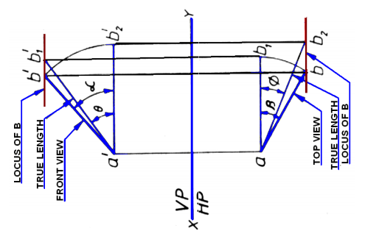

Slide 5
Traces of the Line
A point at which the line intersects a reference plane or meets it imaginarily when extended from either of its end
Points of intersections of a line ( or it’s extension ) with respect to reference planes
A line itself or its extension, where ever touches H.P., that point is called
TRACE OF THE LINE ON H.P => H.T i.e horizontal trace
Similarly, a line itself or it’s extension, where ever touches V.P., that point is called TRACE OF THE LINE ON V.P => V.T i.e vertical trace
V.T.:- It is a point on VP. it is called FV of a point in VP. Hence it’s TV comes on XY line -> denoted as ‘v’
H.T.:- It is a point on HP. it is called TV of a point in HP. Hence it’s FV comes on XY line -> denoted as ‘h’

Slide 6
When the line is parallel to both HP and VP, there will be no traces on the said planes.
Traces of a line observed in the following conditions
Lines perpendicular to one plane and parallel to the other.
Lines inclined to one plane and parallel to the other.
Lines inclined to both the planes

Slide 7
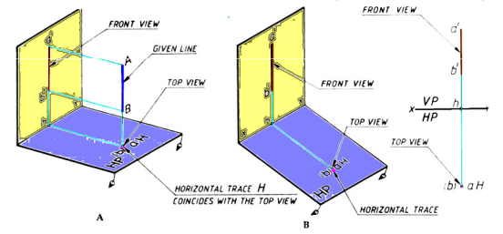
Trace - line perpendicular to one plane and parallel to the other
Since the line is perpendicular to one plane and parallel to the other, the trace of the line is obtained only on the plane to which it is perpendicular, and no trace of the line is obtained on the other plane to which it is parallel.

Slide 8
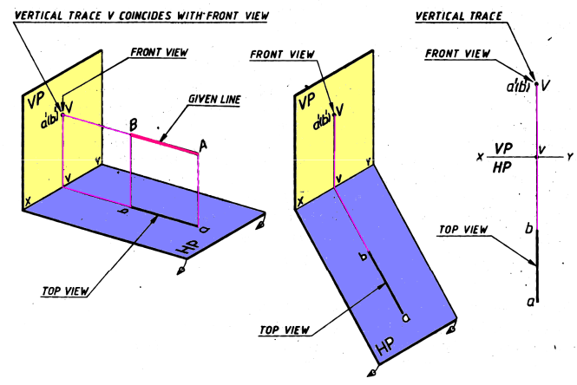
Lines perpendicular to VP and parallel HP

Slide 9
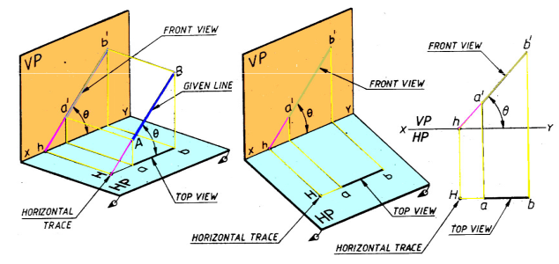
Traces of a line inclined to one plane and parallel to the other
When the line is inclined to one plane and parallel to the other, the trace of the line is obtained only on the plane to which it is inclined, and no trace is obtained on the plane to which it is parallel.
Line inclined at θ to HP and parallel to VP

Slide 10
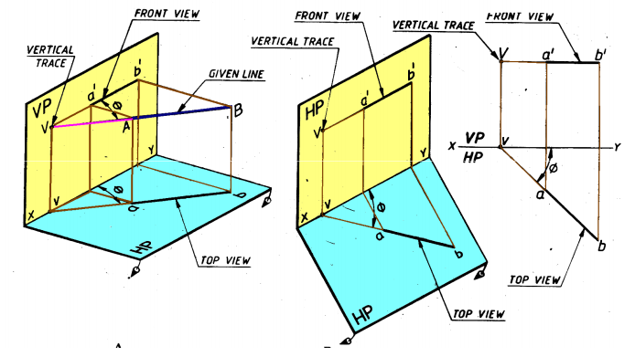
Line inclined at φ to VP and parallel to HP

Slide 11
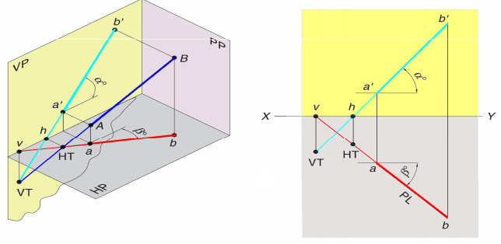
Traces of a line inclined to both the planes
Line inclined at θ to HP and ϕ to VP . The line when extended intersects HP at H, the horizontal trace, but will never intersect the portion of VP above XY line, i.e. within the portion of the VP in the 1st quadrant. Therefore VP is extended below HP such that when the line AB is produced it will intersect in the extended portion of VP at V, the vertical trace

Slide 12
Side view of a line
Represented as a’’b’’ and follow the same steps as side view of a point to draw the Side view of the line
Description of line for side view with one end
- On RPP/LPP
- in front of LPP/ RPP
- from LPP/RPP
Try side for these problem
2. Contd., end c is 20mm in front of LPP
3. contd., the end A is on LPP
7. Contd., end G is 30 mm in front of LPP

Slide 13
Thank You

